Slide 1
Lesson 1.7
HTML forms

Slide 2
Learning Outcomes
Use HTML forms on your website
Collect user inputs
Send user inputs to the backend server for processing

Slide 3
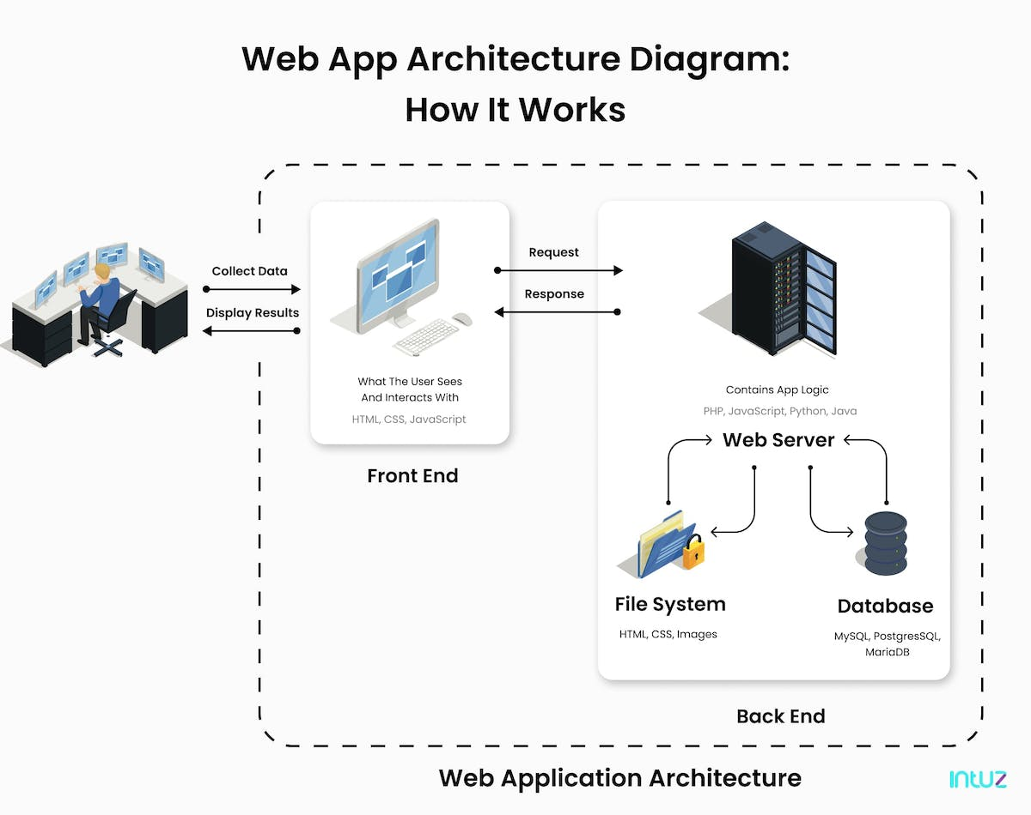
Types of developers:
Front-end developer
Back-end developer
Database developer
Full-stack developer

Slide 4
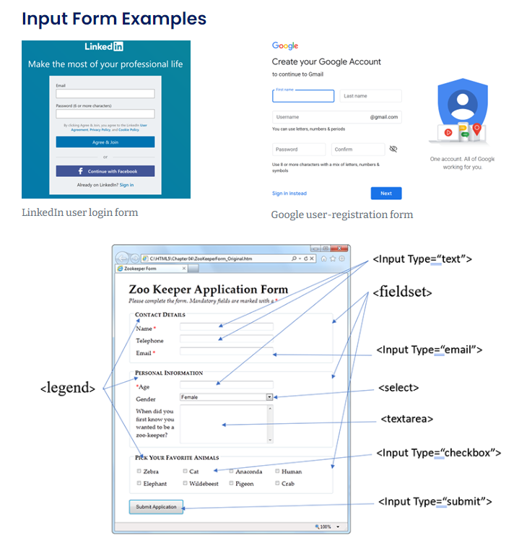
HTML Forms
Forms are used to collect user input
<form></form> element is a container for different types of input elements
Text fields
Checkboxes
Radio buttons
Drop-down lists
User inputs are submitted to a web server for processing
“Submit” button

Slide 5
<form> Attributes
“action” attribute:
Defines the action to be performed when the form is submitted
Usually, the form data is sent to a file on the server
If the attribute is omitted, the action is set to the current page
Example: <form action="/action_page.php">
The form data is sent to a file called "action_page.php". This file contains a server-side script that handles the form data.

Slide 6
<form> Attributes
“method” attribute:
Specifies the HTTP method to be used when submitting the form data
method=“GET” (default)
The form data is sent as URL variables
Useful for “getting” information, such as search queries or database information
Doesn’t change any data
method=“POST”
The form data is sent as an HTTP post transaction
Useful when “posting” (i.e. creating or updating) information, such as creating a new account or posting on social media
Examples:
<form action="/action_page.php" method=“GET">
<form action="/action_page.php" method=“POST">

Slide 7
Form Elements
<label></label>
Defines a label for another form element
Important for screen readers and accessibility
Use the attribute “for” to connect a label with the “id” of its associated form element
Example:
<form> <label for="fname">First name:</label> <input type="text" id="fname" name="fname"> </form>

Slide 8
Form Elements
<input>
Most used form element
No closing tag
Multi-purpose: the attribute type=“[value]” determines the type of <input> element
Examples:
<input type="text”>
<input type="radio”>
<input type=“password”>
<input type="checkbox”>
<input type="button”>
<input type=“file”>
<input type="submit”>

Slide 9
Form Elements
<input> attributes
“name”
The <input> tag must have a name attribute for it to be submitted to the server-side script.
Used to reference the form data after the form is submitted
<input type="text" id="fname" name="fname">
“id”
Used to associate the input with a label, as well as CSS and JavaScript
“value”
Specifies an initial value, but can be overridden by the user.
<input type="text" id="fname" name="fname" value="John">
“checked”
Indicates that a checkbox or radio button should be selected by default, but can be overridden by the user.
<input type="checkbox" name="vehicle1" value="Bike” checked>

Slide 10
Form Elements
<input> attributes
“readonly”
Specifies that an input field is read-only. The value cannot be changed by the user, but still functions like an input.
<input type="text" id="fname" name="fname" value="John" readonly>
“disabled”
Specifies that an input field is disabled. The user cannot use it and it won’t be submitted.
<input type="text" id="fname" name="fname" value="John" disabled>
“size”
Specifies the visible width, in characters, of an input field.
<input type="text" id="fname" name="fname" size="50">
“placeholder”
Specifies a short hint that describes the expected value of an input field.
<input type="tel" id="phone" name="phone” placeholder="123-45-678">

Slide 11
Form Elements
<select></select>
Used to create a drop-down list.
Uses <option> tags, placed between the <select></select> tags, to define the available options.
The first option is selected by default, unless the “selected” attribute is used to set a different default selection.
<select name="cars" id="cars"> <option value="volvo">Volvo</option> <option value="saab">Saab</option> <option value="mercedes">Mercedes</option> <option value="audi” selected>Audi</option> </select>

Slide 12
Form Elements
<textarea></textarea>
Multi-line text input control
Use the “rows” and “cols” attributes to set its visible size.
Default text can be placed between the <textarea></textarea> tags.
<textarea id=“comments" name=“comments" rows="4" cols="50">Default text</textarea>
Notes:
CodePen: Form Examples

Slide 13
Which Form Element is Best?
Business situation:
A company's HR department is creating a form for job applicants to submit their resumes. Which form control should they use to allow applicants to upload their files?
Options:
A) Text Input
B) Text Area
C) File Upload
D) Radio Buttons
Notes:
C

Slide 14
Which Form Element is Best?
Business situation:
A website wants users to sign up for their newsletter. Which form control should they use to allow users to opt-in or opt-out?
Options:
A) Checkbox
B) Dropdown Menu (Select)
C) Text Input
D) Radio Buttons
Notes:
A is best
Can do B and D

Slide 15
Which Form Element is Best?
Business situation:
An online survey needs participants to rate their satisfaction level on a scale of 1 to 5. Which form control should they use?
Options:
A) Checkbox
B) Dropdown Menu (Select)
C) Text Input
D) Radio Buttons
Notes:
D is best
Can do B

Slide 16
Which Form Element is Best?
Business situation:
An e-commerce company wants customers to leave detailed feedback about their recent purchase. Which form control should they use?
Options:
A) Text Input
B) Dropdown Menu (Select)
C) Text Area
D) Radio Buttons
Notes:
A

Slide 17
Which Form Element is Best?
Business situation:
A website needs users to select their province from a list of options. Which form control should they use?
Options:
A) Checkbox
B) Dropdown Menu (Select)
C) Text Input
D) Radio Buttons
Notes:
B
Can do D

Slide 18
Which Form Element is Best?
Business situation:
A conference registration form requires attendees to select all the workshops they want to attend. Which form control should they use?
Options:
A) Checkbox
B) Dropdown Menu (Select)
C) Text Input
D) Radio Buttons
Notes:
A (allows for multiple selections)

Slide 19
Learning Activities
1.7.1 – “Create an HTML Form to Match the Following View”
1.7.2 – “Create the Following HTML Customer Registration Form to Match the Following View”

Slide 20
For next class
Read Lesson 1.8
Do Learning Activity 1.8.1
Assessments Reminder:
GLA 1 is due by February 13, 3:30pm
Engagement is worth 10% of your final grade. Engage by sharing code, asking or answering questions, etc.
All assessment dates have been posted in the D2L calendar.
See the “Assignments Policy” for late submission procedures.

Slide 21
References
https://www.intuz.com/guide-on-web-app-architecture

